Slide 1
Lab 03
Implementation of Dual and Complement Functions
Source: Purdue ECE270

Slide 2
INSTRUCTIONAL OBJECTIVES:
To learn how to implement simple logic functions using discrete 74HC-series components
To review the difference between the dual of a function and the complement of a function
To review how to measure logic signal propagation delays using the digital oscilloscope
2

Slide 3
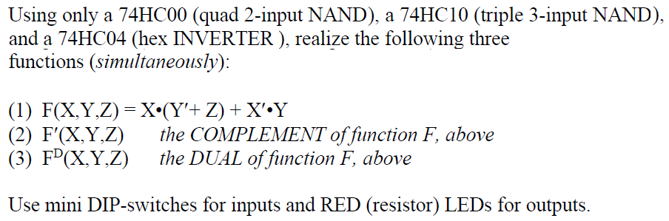
EXPERIMENT DESCRIPTION
Hint: 1. F = X(Y’+Z) + X’Y = XY’ + XZ + X’Y
2. The dual of an expression is formed by simultaneous interchange
of the operator “•” and “+”; and the elements “0” and “1”

Slide 4
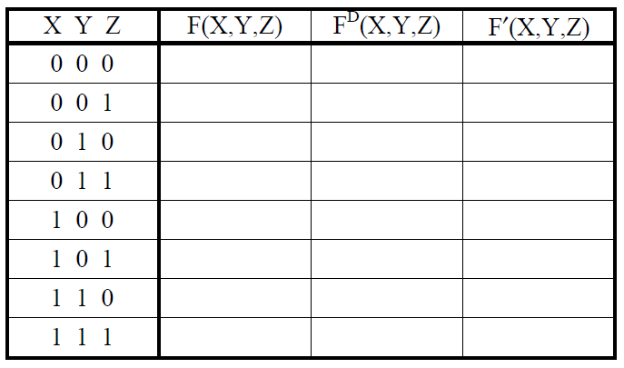
STEP (1): CIRCUIT CONSTRUCTION AND VERIFICATION
Fill out the truth table below, by hand, for the three functions you are to implement in this lab experiment.

Slide 5
STEP (1): CIRCUIT CONSTRUCTION AND VERIFICATION
Using pen and paper to design a circuit that implements three functions simultaneously, with only one 74HC00, one 74HC04, and one 74HC10.
Construct your circuit on a breadboard.
Provide your circuit with each possible input combination to verify its operation, and fill out the truth table below. After completing the truth table below, compare it to the truth table you completed in previous page.
If there are discrepancies, you will need to “debug” your circuit/design!

Slide 6
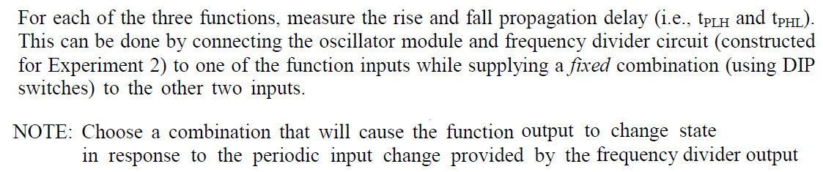
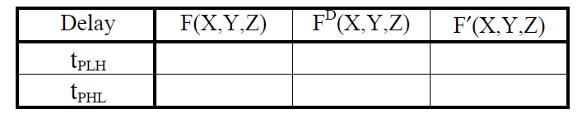
STEP (2): PROPAGATION DELAY MEASUREMENTS

Slide 7
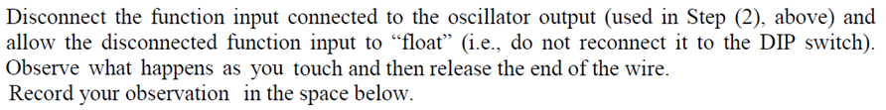
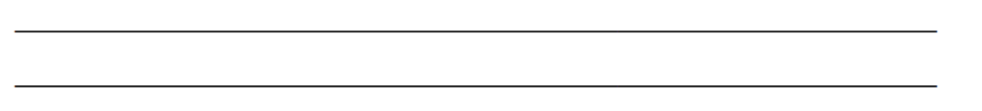
STEP (3): FLOATING INPUT INVESTIGATION

Slide 8
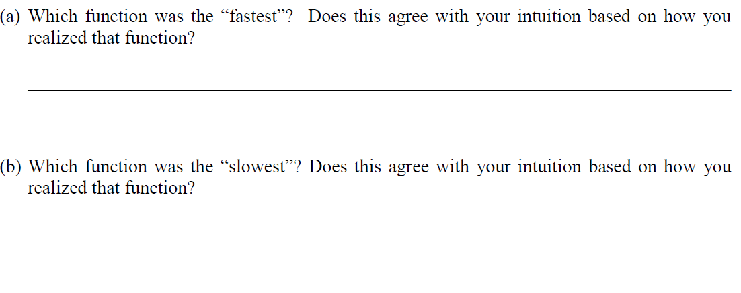
STEP (4): THOUGHT QUESTIONS

Slide 9
More Hints

Slide 10
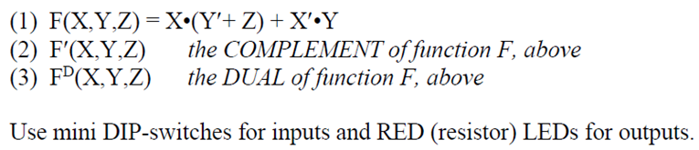
STEP (1): CIRCUIT CONSTRUCTION AND VERIFICATION
0
0
1
1
1
1
0
1

Slide 11
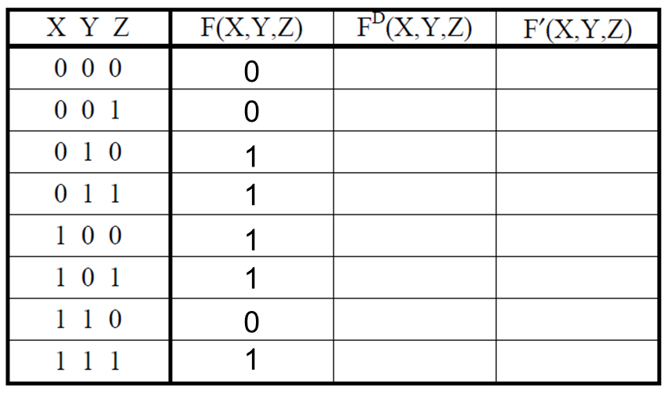
STEP (2): PROPAGATION DELAY MEASUREMENTS
量測 F(X,Y,Z) 的 t_{PLH} , t_{PHL}
可以設定Y=Z=0, 然後將
exp2的7474輸出接到X,
就可以看到F的輸出變化
設定Y=0, Z=1, or Y=1, Z=0
也可以量測propagation delay

